Slide 1

Competitive Programming From Problem 2 Solution in O(1)
P
T
H
I
N
K
F
A
S
T
S
Graph Theory
2 Satisfiability (2SAT)
Mostafa Saad Ibrahim
PhD Student @ Simon Fraser University

Slide 2
Needed Background
Connectivity or SCC - Not Covered.
Truth Value
Truth Table
Logical Implication
Implication Graph
Conjunctive normal form

Slide 3
Connectivity / SCC
We will discuss 2 solutions
Slow: Floyd / DFS
Fast: SCC
Both topics are not covered here
Revise their videos from my channel

Slide 4
Truth value
In classical logic the truth values are:
true (1 or T) and
untrue or false (0 or ⊥)
That is … boolean variables :)
bool bVisited = true;
bVisited = false;

Slide 5
Truth Table
Evaluating all possible values the logic function can take
Functions: NOT ¬, OR ∨, AND ∧
1 boolean values have 2 combinations
2 boolean values have 4 combinations
3 boolean values have 8 combinations
We will focus on the basic 3 + implication

Slide 6
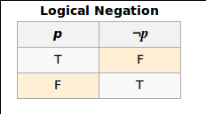
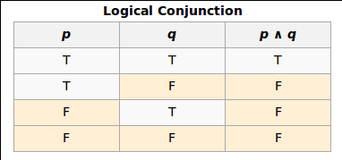
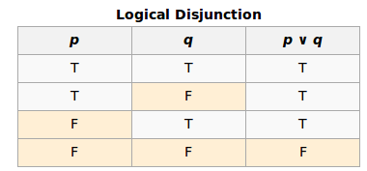
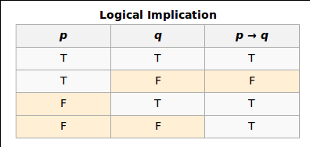
Truth Table
Src: https://en.wikipedia.org/wiki/Truth_table

Slide 7
Logical Implication
if p then q (symbolized as p → q)
p is a premise and q is conclusion
if p is true, q must be true
if p is false, q can be whatever
That is only 1 case is false: p = true and q = false
P = The sky is overcast. Q = The sun is not visible.
if sky is overcast → sun is not visible
if sky is NOT overcast →sun may or may not be visible (e.g. some eclipse occurs covering sun)
Logic fails: if sky is overcast but we see the sun!!!!
(if p then q) equivalent to (if !q then !p)

Slide 8
Implication Graph
Assume: If a then b. if b then !c. if !c then d
Then ⇒ if a then d
Then ⇒ if a = 1, then b = 1, c = 0, d = 1
Implication graph
Each variable will have 2 nodes: x and !x
Each implication is edge (b →!c) ⇒ Edge (b, !c)
Then
Any path in such graph represents a new implications
X and !X shouldn’t be on a cycle (both can’t be true)
a
b
!c
d

Slide 9
Implication Graph
if a then b?
If b is true ⇒ a must be true
If b is false ⇒ a must be false
equal to: if !b then !a
if a then b + if b then c?
if c = true ⇒ a = b = true
if c = false ⇒ a = b = false
if b = true ⇒ a = c = true
if b = false ⇒ a = false, but c = ?
There is path: a=> b => c and path !c => !b => !a

Slide 10
Implication Graph
Set of variables on cycle = ALL same value
if true, keep go forward or backward, all assigned true
if false, keep go backward, all assigned false
If we have cycle with value X
There must be other cycle with complement node
Cycle edges will be switched edges
All this cycle is !X
E.g. Cycle 1 = true: (a, !b), (!b, c), (c, a)
Then cycle 2 = false: (!a, !c), (!c, b), (b, !a)
Hint: If have some cycles = compress to a node

Slide 11

Conjunctive normal form
CNF = a conjunction (and) of clauses, where a clause is a disjunction (or)

Slide 12
2-Satisfiability
Given CNF with each clause of 2 terms only
Is it possible to assign variables so than CNF is true?
(x1∨x2)∧(x2¯∨x3¯)∧(x1¯∨x3)
x1 = 1, x2 = 0, x3 = 1
(1 ∨ 0) ∧ (1 ∨ 0) ∧ (0 ∨ 1) = true
We can do that using 2^n code..Better?

Slide 13
2-Satisfiability
Thinking: Is it possible to express CNF Clause as implication?
We need to force each Clause (a ∨ b) = true?
What does it imply: (a ∨ b) = true?
if a = 0, then b must = 1 .. hence (0 or 1) = 1
if b = 0, then a must = 1 .. hence (1 or 0) = 1
Note: if a = 1 or b = 1 ⇒ We can’t imply something
Create implication graph
clause ⇒ 2 edges
(a v b) ⇒ edge(!a, b) and edge(!b, a)

Slide 14
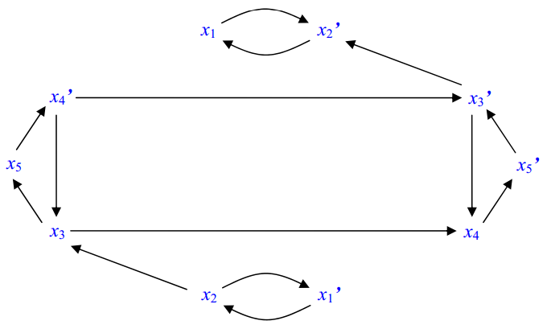
2-Satisfiability
(x1∨x2)∧(x2¯∨x3)∧(x1¯∨x2¯)∧(x3∨x4)∧(x3¯∨x5)∧(x4¯∨x5¯)∧(x3¯∨x4)
x1∨x2 ⇒ E(!x1, x2), E(!x2, x1)
7 clauses = 14 edges
5 vars = 10 nodes
Src: http://cs.stackexchange.com/questions/35425/time-complexity-of-solving-a-set-of-2-sat-instances

Slide 15
2-Satisfiability
Assume edges (a, b) (b, c) (c, d)
Recall: set b = true ⇒ a = c = d = true
Recall: set b = false ⇒ a = false .. no constraint on c, d
Recall: we have 2 paths: (a ⇒ d) and (!d ⇒ !a)
What if we have path from x to !x?
Let x = true, then !x = true (e.g. x = false) ⇒ contradict
Let x = false, then no implication constraints on any forward variables. Hence, !x = true ⇒ ok
Summary, must: x = false
What if we have path from !x to x?
Similarly, must x = true

Slide 16
2-Satisfiability
What if we have path from x to !x AND from !x to x (e.g. both on cycle)?
We can NOT find correct assignment
Summary
If any 2 variables x and !x on cycle => No solution
Otherwise, there is a solution.
We can do DFS to check cycles or use SCC
Note: if path from X to both Y and !Y
Then X => !Y => !X is a path too and X = false

Slide 17
Code: Doubling the nodes
Assume we have N = 5, and need 2N graph
One mapping:
0 ⇒ (0, 1), 1 ⇒ (2, 3), 2 ⇒ (4, 5)....
Can be coded with xor (x and x^1)
Or check if even return odd, if odd return even
Other mapping
0 ⇒ (0, N), 1 ⇒ (1, N+1), 2 ⇒ (2, N+2)....
Write a simple function to NOT(x)
Takes i and return its !i to ease code

Slide 18
Slow Approach: build-check
Create graph of 2N nodes for the N variables
For each clause (a v b):
Add 2 edges (!a, b), (!b, a)
Compute Transitive Closure
Reason - 1: Know if variables on cycle or not.
Reason - 2: Know variables forced to be zero
Recall: Path x to !x ⇒ x = false
Recall: Path !x to x ⇒ x = true
Otherwise...x NOT forced to value
For each variable, check if x and !x NOT on cycle

Slide 19
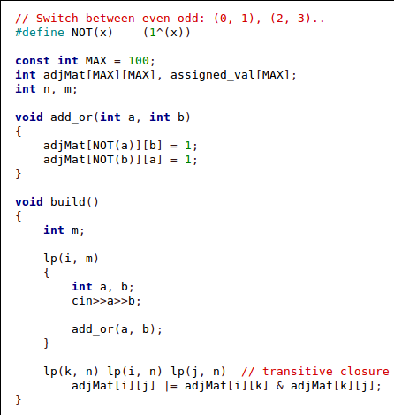
Slow Approach: build

Slide 20
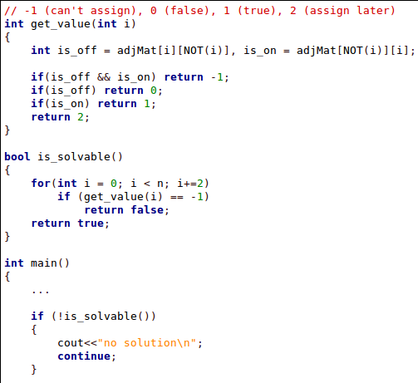
Slow Approach: check

Slide 21
Slow Approach: Assign
Find unassigned variable that can be true
E.g. Not forced to be false (path x to !x)
In other words, forced to true or not forced at all
By implication rules:
Any reachable node in the graph must be true too
Any node x = true => !x = false
Keep doing so as long as some variables unassigned

Slide 22
Slow Approach: Assign
Important false variable paths:
X2 - X2’
X3 - X3’
X5 - X5’
X1? Allowed. X1 = true (X1’ = False)
Reachable from X1? X2’ = true(X2 = False)
X1’? Marked
X2, X2’? Marked
X3? Must be false. X3’ = true
X3’? Marked
X4? Allowed, X4 = true(X4’ = False)
Reachable from X4? X5’, X3’, X2’, X1 = true (X5, X3, X2, X1’ = false)
Src: http://cs.stackexchange.com/questions/35425/time-complexity-of-solving-a-set-of-2-sat-instances

Slide 23
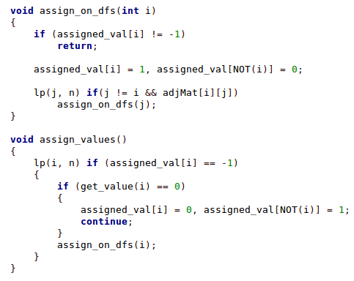
Slow Approach: Assign

Slide 24
Fast Approach
Build graph
Find SCC
SCC actually can tell us if 2 vars on cycle
X and !X if part of same component => cycle => No sol
Compute Component Graph
All nodes on cycle must have same value
Complement nodes must be other comp node
Recall: if a then b ⇒ if !b then a
Get reverse topological order for components
Using tarjan, we get all of this with 1 DFS

Slide 25
Identify SCCs - Component Graph
x2, x1’
x3, x5, x4’
x3’, x4, x5’
x1, x2’

Slide 26
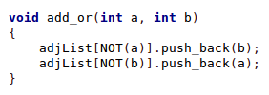
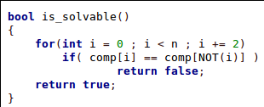
Checking Satisfiability?
x2, x1’
x3, x5, x4’
x3’, x4, x5’
x1, x2’
Any component has variable and its negation? E.g. x1 and x1’ ?
No ⇒ then solution exists

Slide 27
Tarjan simple modification
Instead of explicitly building component graph
Let’s define root component node
Any node in the component is ok..e.g. root node
Recall the root node: dfn# = lowlink #
E.g. if we have 4 components we can have:
(0, 10), (1, 7), (2, 6), (3, 12)...(component, node)
Recall: Tarjan components are reverse topological order: 0, 1, 2, 3 = correct order

Slide 28
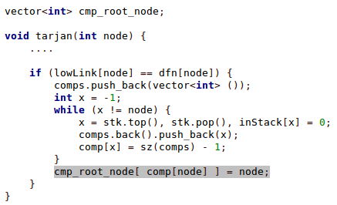
Tarjan simple modification

Slide 29
Assigning Values
Order components: reverse topological order
If component unassigned
Set it to 1
Set its dual component to 0
Dual component of C
Let node x be the root node of this component
Let !x be its dual node...find its component !C
Set !C = 0
Assign all the nodes of component to component value

Slide 30
Assigning Values
C1 = x2, x1’
C2 = x3, x5, x4’
C3 = x3’, x4, x5’
C4 = x1, x2’
Notice: C3 = !C2
Find reverse topological order: C4, C3, C2, C1...Assign By order
C4: unassigned. Set to 1 (e.g. x1 = 1, x2 = 0). Set dual component C1 = 0
C3: unassigned. Set to 1 (e.g. x3 = 0, x4 = 1, x5 = 0). Set C2 = 0
C2: assigned already
C1: assigned already
(x1∨x2)∧(x2¯∨x3)∧(x1¯∨x2¯)∧(x3∨x4)∧(x3¯∨x5)∧(x4¯∨x5¯)∧(x3¯∨x4)
(1∨0)∧(1∨0)∧(0∨1)∧(0∨1)∧(1∨1)∧(0∨1)∧(1∨1) = 1

Slide 31
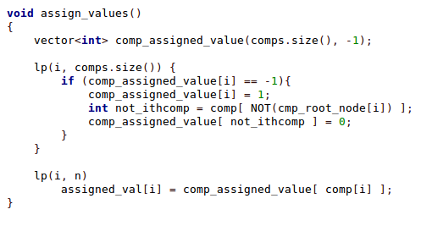
Assigning Values

Slide 32
CNF and Implications
Sometimes we can formulate problem easily as CNF to do 2SAT
Sometimes, you extract implication statements and model them. Then SCC as mentioned.
Your turn:
How to early force variable x to value?
Given (a, b) how to allow only (1, 0) (0, 1) but not (1, 1)

Slide 33
Further readings?
I escaped correctness for 2 assignment methods
For proofs
link 1
link 2
link 3

Slide 34
تم بحمد الله
علمكم الله ما ينفعكم
ونفعكم بما تعلمتم
وزادكم علماً

Slide 35
Problems
SPOJ(BUGLIFE, TORNJEVI), UVA(11294, 10319), LiveArchive(4452), CF(228E, 27D, gym-100570-D), TJU(2506), SGU(307)
http://www.oi.edu.pl/php/show.php?ac=e181113&module=show&file=zadania/oi8/spokojna
http://web.ics.upjs.sk/ceoi/documents/tasks/party-tsk.pdf

